Slide 1


Final Year Project
Multi-Purpose AI Password Analysis Tool
(Offensive and Defensive AI Warfare)
Supervised By: Mansoor Alam (Designation)

Slide 2
Project Team
Osama Khalid (27971)
Sardar M.Zeeshan khan(27969)
Salman Ali(27667)

Slide 3
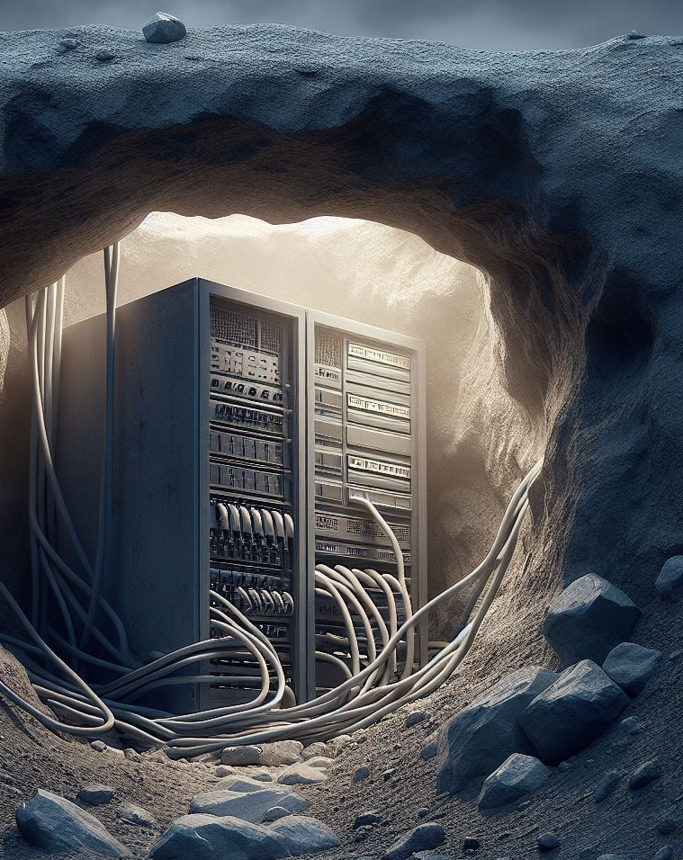
"The only truly secure system is one that is completely powered off, cast in concrete, and sealed in a lead-lined box buried a mile underground ."
-Bruce Schneier (security expert)

Slide 4
Table of Content
Introduction and Background
Opportunities and Stack Holders
Market Survey
Problem Statement
Proposed Solution
Project Scope

Slide 5
BACKGROUND AND INTRODUCTION

Slide 6
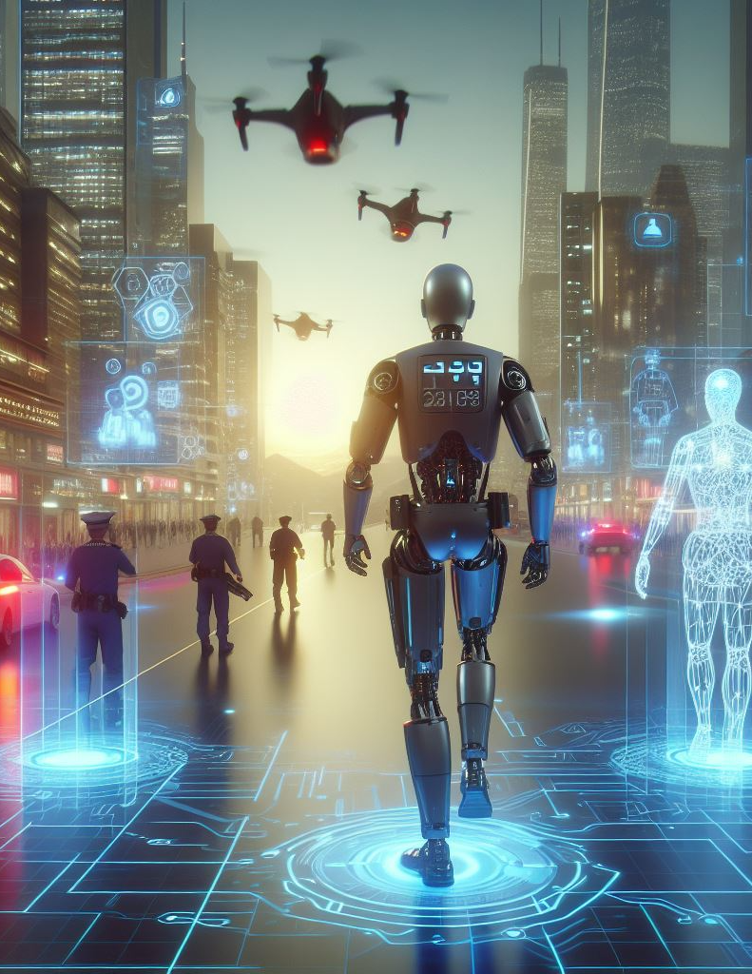
AI: Transforming Offensive and Defensive Security
Offensive Applications:
Threat Modeling
Vulnerability Analysis
Automated Attacks
Defensive Applications:
Anomaly Detection
Intrusion Prevention.
Personalized Security Solutions

Slide 7
Opportunities and Stake Holders

Slide 8

Opportunities
Enhanced Security Assessments: Businesses and individuals can leverage the tool for penetration testing and vulnerability assessments, identifying potential weaknesses in their password security policies and practices.
AI-driven Offensive and Defensive Capabilities: Utilizing AI for both offensive (password cracking) and defensive (password strength assessment) purposes provides a comprehensive approach to password security management.

Slide 9

Stake Holders
Businesses: Companies aiming to improve their overall cybersecurity posture by identifying and mitigating password-related vulnerabilities.
Security Professionals: Penetration testers and security consultants who can use the tool for vulnerability assessments and ethical hacking activities.
Law Enforcement: Agencies might leverage the tool for lawful investigations adhering to court orders and legal guidelines.

Slide 10
Market Survey

Slide 11
Tool | John the Ripper | RainbowCrack | OphCrack | L0phtCrack | Aircrack-ng
Type | Password Cracker | Password Cracker | Password Cracker | Password Cracker | Wi-Fi Network Security Tool
Supported Platforms | Windows, Linux, macOS | Windows, Linux | Windows, Linux | Windows | Linux, macOS
Password Hashes Supported | Various (Unix, Windows, etc.) | LM, NTLM, MD5, SHA1, SHA256, SHA512 | LM, NTLM | LM, NTLM | WEP, WPA, WPA2
Attack Methods | Dictionary, Brute Force, Hybrid | Precomputed Hash Tables | Rainbow Tables, Brute Force | Dictionary, Brute Force | Dictionary, Brute Force, WPS PIN
Speed | Fast | Depends on Rainbow Table size | Moderate | Fast | Depends on hardware and complexity of the password
User Interface | Command Line | Command Line | GUI | GUI | Command Line
License | Open Source | Freeware | Open Source | Commercial | Open Source
Usage | Penetration Testing, Password Auditing | Password Cracking | Password Recovery | Password Cracking | Wi-Fi Network Security Testi

Slide 12

"Your password is the key to your digital life. Choose it wisely, and guard it fiercely."

Slide 13
Problem Statement

Slide 14
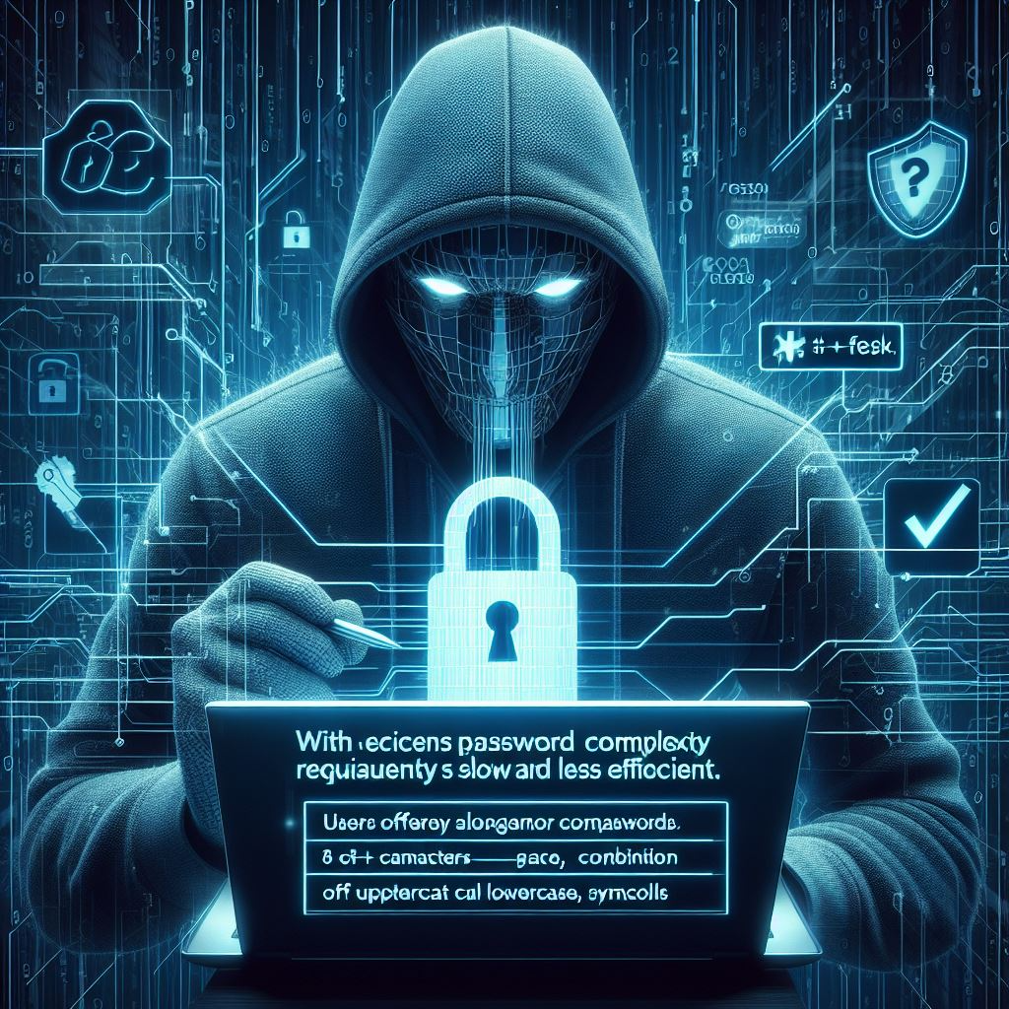
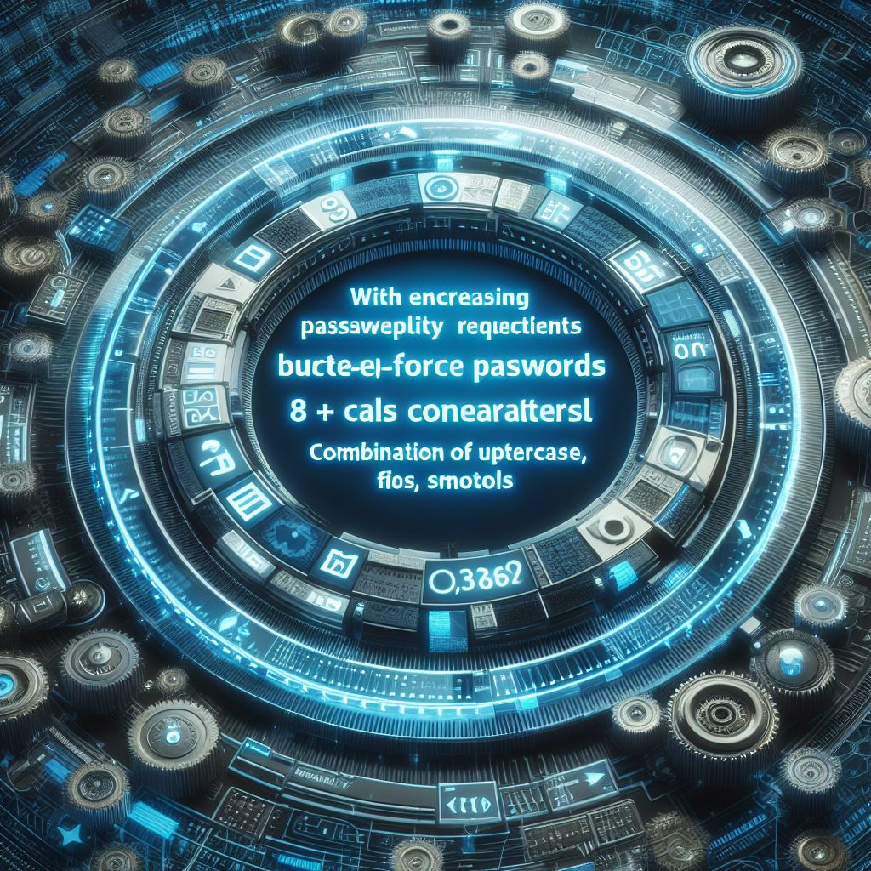
Problem Statement
With increasing password complexity requirements, brute-force attacks become significantly slower and less efficient.
Users often employ longer and more complex passwords (e.g., 8+ characters, combination of uppercase, lowercase, symbols) making traditional brute-force methods impractical.

Slide 15
4^(26+26)=20282409603651670423947251286016
Length | Upper Case | Upper +Lower Case | Upper+Lower+Numeric | Upper+Lower+Numeric+Special Char
4 | 4.5036E+15 | 2.02824E+31 | 2.12676E+37 | 3.92319E+56
5 | 1.49012E+18 | 2.22045E+36 | 2.1684E+43 | 5.04871E+65
6 | 1.70582E+20 | 2.90981E+40 | 1.75945E+48 | 1.40029E+73
7 | 9.38748E+21 | 8.81248E+43 | 2.48931E+52 | 2.74926E+79
8 | 3.02231E+23 | 9.13439E+46 | 9.80797E+55 | 7.77068E+84
9 | 6.46108E+24 | 4.17456E+49 | 1.45558E+59 | 4.998E+89

Slide 16
Length | Combination
4²⁶⁺²⁶ | 2220446049250313080847263336181640625
4²⁶⁺²⁶⁺¹⁰ | 21267647932558653966460912964485513216
5²⁶⁺²⁶ | 29098125988731506183153025616435306561536
5²⁶⁺²⁶⁺¹⁰ | 21684043449710088680149056017398834228515625
Length | Upper Case | Upper + Lower Case | Upper + Lower + Numeric | Upper + Lower + Numeric + Special Char
4 | 4.5036E+15 | 2.02824E+31 | 2.12676E+37 | 3.92319E+56
5 | 1.49012E+18 | 2.22045E+36 | 2.1684E+43 | 5.04871E+65
6 | 1.70582E+20 | 2.90981E+40 | 1.75945E+48 | 1.40029E+73
7 | 9.38748E+21 | 8.81248E+43 | 2.48931E+52 | 2.74926E+79
8 | 3.02231E+23 | 9.13439E+46 | 9.80797E+55 | 7.77068E+84
9 | 6.46108E+24 | 4.17456E+49 | 1.45558E+59 | 4.998E+89

Slide 17
Proposed Solution

Slide 18
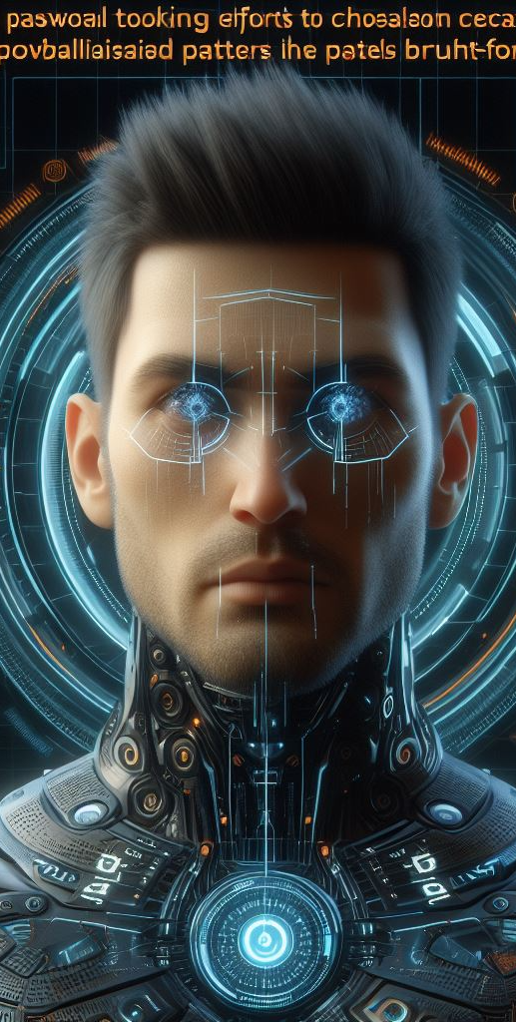
Proposed Solution
Our AI-powered tool leverages advanced algorithms and Human like passwords data to:
Focus cracking efforts on statistically probable password patterns :This reduces the search space and accelerates the cracking process compared to traditional brute-force methods.
Analyze password strength based on complexity metrics and AI-driven pattern recognition. This identifies potential weaknesses in complex passwords, aiding in targeted cracking attempts.

Slide 19
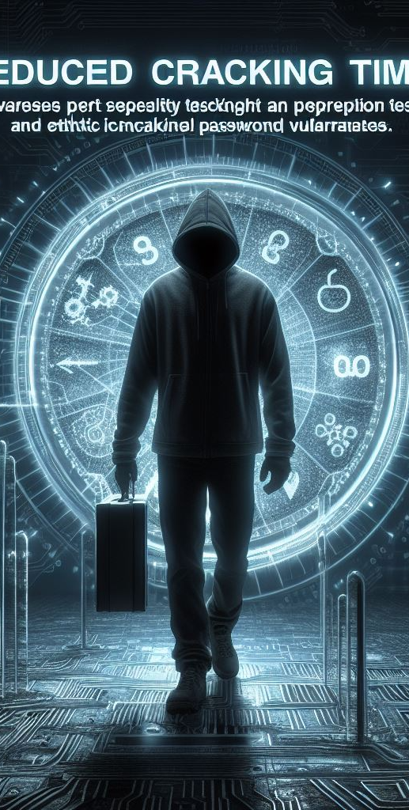
Proposed Solution
Benefits:
Reduced cracking time: This capability empowers security professionals to perform penetration testing and ethical hacking more efficiently, uncovering potential password-related vulnerabilities.
Improved vulnerability assessment: By analyzing password strength and identifying patterns, the tool provides valuable insights for organizations to strengthen their password policies and overall security posture.

Slide 20
Project Scope

Slide 21
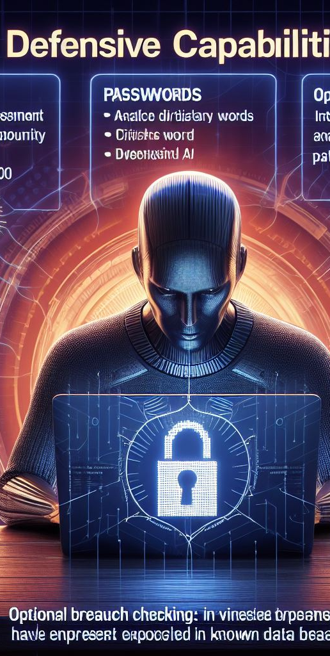
Project Scope
Defensive capabilities:
Password strength assessment: Analyze password complexity, identify dictionary words, and check for patterns using AI.
Optional Breach checking: Integrate with online databases to verify if entered passwords and email IDs have been exposed in known data breaches.

Slide 22
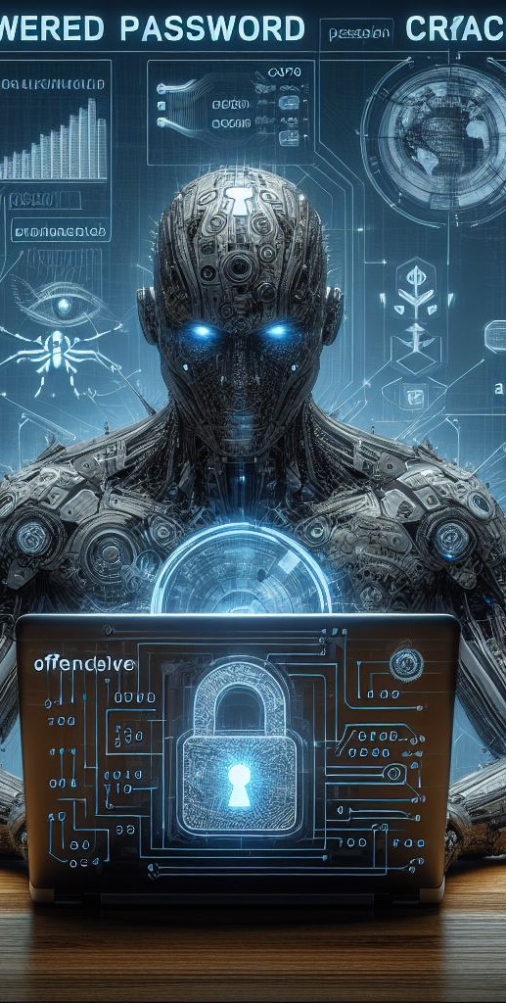
Project Scope
Offensive capabilities (for ethical purposes only):
AI-powered password cracking: Utilize correlation of password data and advanced algorithms to efficiently crack passwords within a specified scope and with proper authorization.

Slide 23

Any Question?

Slide 24

References
https://posts.specterops.io/deeppass-finding-passwords-with-deep-learning-4d31c534cd00
https://ieeexplore.ieee.org/abstract/document/9552430
https://www.sciencedirect.com/science/article/pii/S0020025518302366?casa_token=QnobZtTT-nQAAAAA:ZUQdmVBOId58XFG1Sp5xbuBLQdIui7dvw4fKJzUqfwLr6doVbFtBep38V2hDqVt_26zTbM_Sj5I

Slide 25
Background and Introduction

Slide 26
Endeavour
Describe roles of your team members
Describe your software development process
Describe your way of working as a team

Slide 27
Requirements Summary

Slide 28
Design Summary

Slide 29
Methodology
<Add diagram according to your project domain i.e., Methodology diagram (AI, IOT etc) OR Flow chart (Data Structures, Algorithms etc)>
<Also explain all steps in bullet points>

Slide 30
Implementation Summary

Slide 31
Experiments and Results Summary

Slide 32
Testing Summary

Slide 33
CONCLUSION AND OUTLOOK

Slide 34
Conclusion & Outlook

